Slide 1


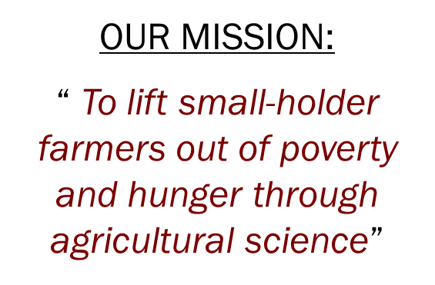
Corona and Rural Competence Development in Africa
Jack Elliot
Regional Director for Africa

Slide 2
The African Union Sanitary and Phytosanitary (SPS) Policy Framework for Africa
The Continental SPS Committee
The Department of Rural Economy and Agriculture

Slide 3
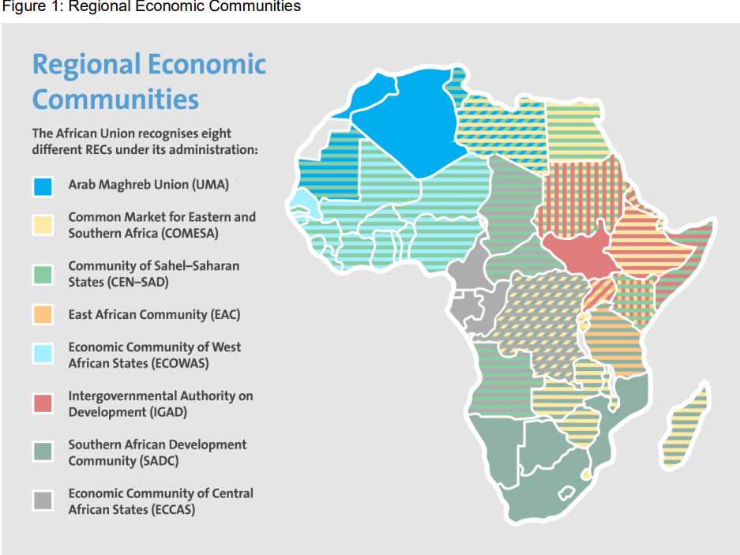

Slide 4
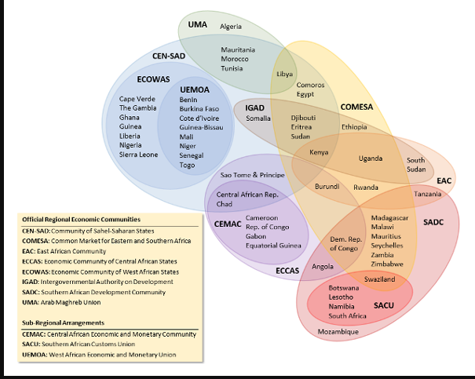

Slide 5
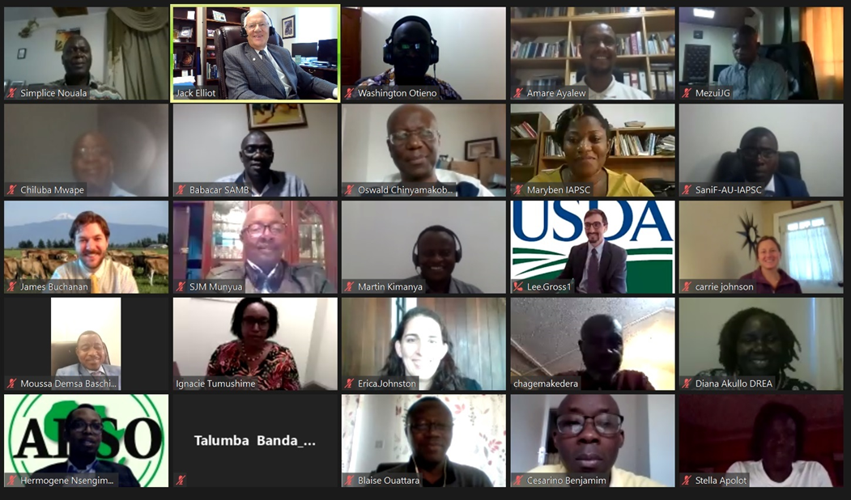
So, I asked the Continental SPS Committee 3 questions:

Slide 6
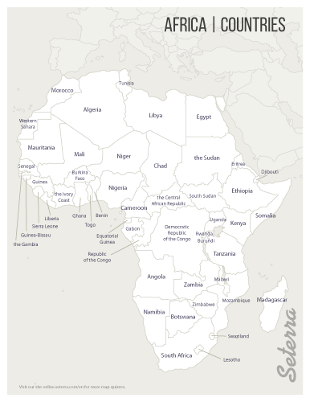
How are you, your organization, or country coping with the pandemic?
What is your (or your organization’s or country’s) levels of competence (strengths/weaknesses) in addressing the pandemic?
What is the a difference between rural and urban communities in coping with the pandemic?

Slide 7
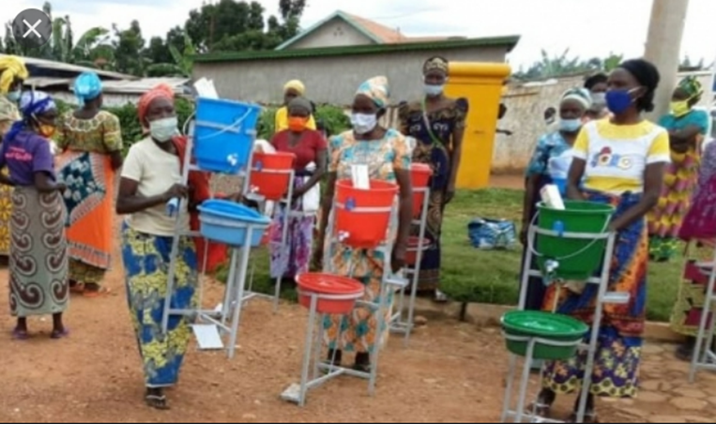
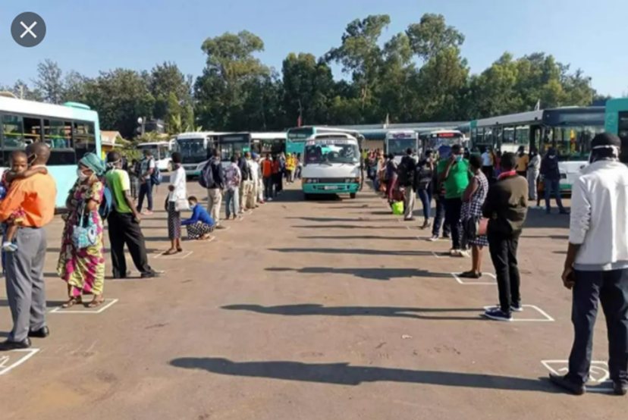
1. How are you, your organization, or country coping with the pandemic?
General consensus: Most countries addressed COVID-19 issues by mask usage, hand washing, and social distancing. Many day-to-day operations and activities successfully transferred to safe operations because of these simple solutions.

Slide 8

2. What is your (or your organization’s or country’s) levels of competence (strengths/weaknesses) in addressing the pandemic?
Strengths:
  Adjusting to online and available technology.
  Providing accurate and timely information.
  Following safe protocols, early on.
Weaknesses:
  As the pandemic lingered, complacency against safe protocols increased.
  Vaccine and medical infrastructures need additional support.
  Infrastructures varied widely as did testing capacity.
  International trade lagged due to delays in addressing quarantine regulations.

Slide 9
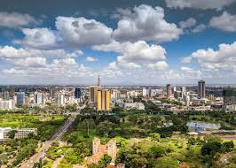
3. What is the a difference between rural and urban communities in coping with the pandemic?
Urban:
  Higher percentage of cases.
            Due to high population densitiy.
            A more active commercial sector.
            And some establishments not following protocols.
  Better access to medical facilities.
  Essential pandemic equipment and supplies are more available.
  Emergency response time quicker.
  Accepted and followed safe protocols.

Slide 10
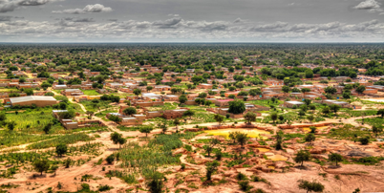
3. What is the a difference between rural and urban communities in coping with the pandemic?
Rural:
  Lower percentage of cases.
            Due to low population densitiy.
            A less active commercial sector.
            And some establishments not following protocols.
  Less access to medical facilities.
  Essential pandemic equipment and supplies are usually not available.
  Emergency response time is very limited.
  Safe protocols were often ignored.

Slide 11
Some other key points
Challenges were encountered when changing important meetings, education, and other gatherings to online due to power outages, unreliable Internet, and a steep learning curve. Most of these challenges were addressed in the first few months of the pandemic and by October 2020 we conducted 2 full weeks of on-line workshops with the SPS Continental Committee.
All rural and urban schools have been strictly following the protocols and guidelines.

Slide 12
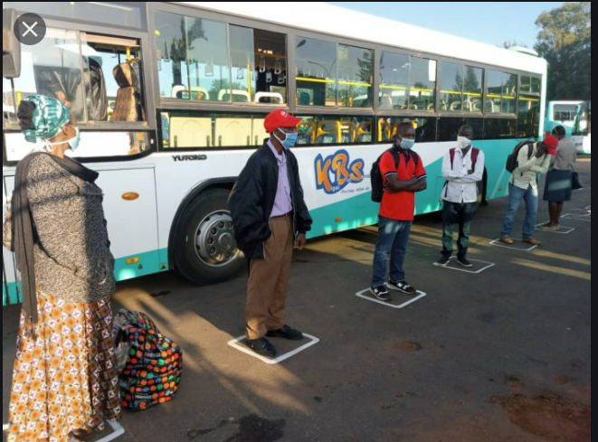
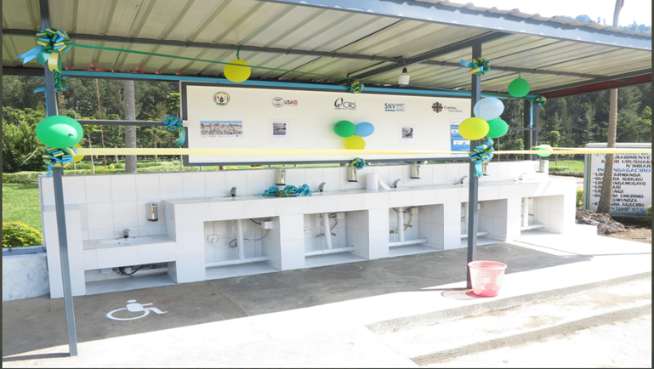
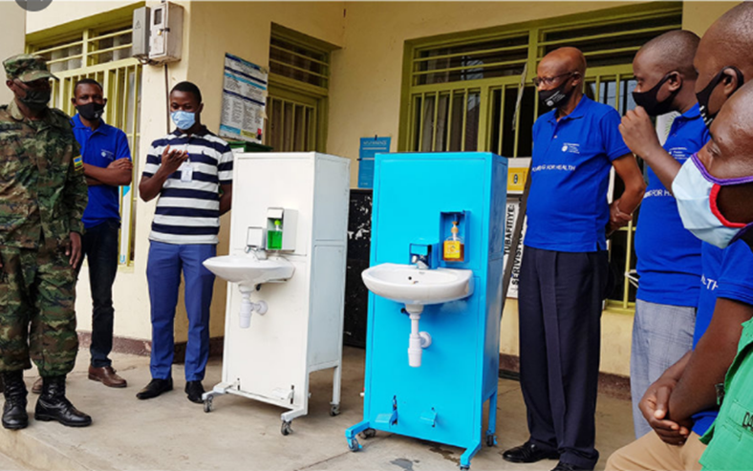
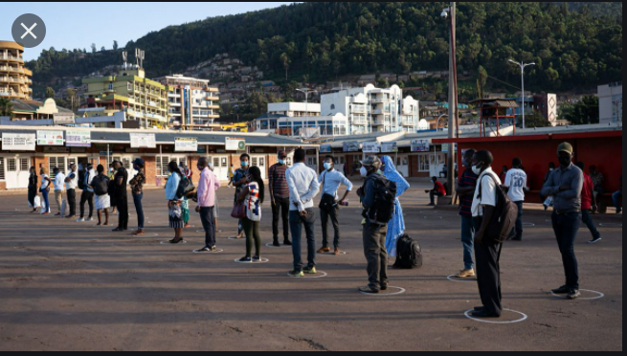
Thank You

