Slide 1

Review of Research on Corona Coping Competence
Martin Mulder
March 22, 2021
www.mmulder.nl
Source: https://www.roselinde.me/amsterdam-coronavirus-lockdown-photos/

Slide 2
Preliminary remarks
Adedoyin et al. (2020)
Code et al. (2020)
Ferdig et al. (Eds) (2020)
García et al. (2020)
Hodges et al. (2020)
Hollweck et al. (2020)
Ipsos (2020)
Mishra (2020)
Murphy et al. (2020)
Nagpal et al. (2020)
OECD (2020).
Pokhrel et al. (2021)
Sansom et al. (2020)
Stevens et al. (2020a)
Stevens et al. (2020b)
Smith et al. (2020)
Sohrabi et al. (2021)
Toquero (2020)
Williamson et al. (2020)
Avalanche of papers
Reactive responses of papers
Wide variation of themes
The Pandemic as selling point of papers

Slide 3
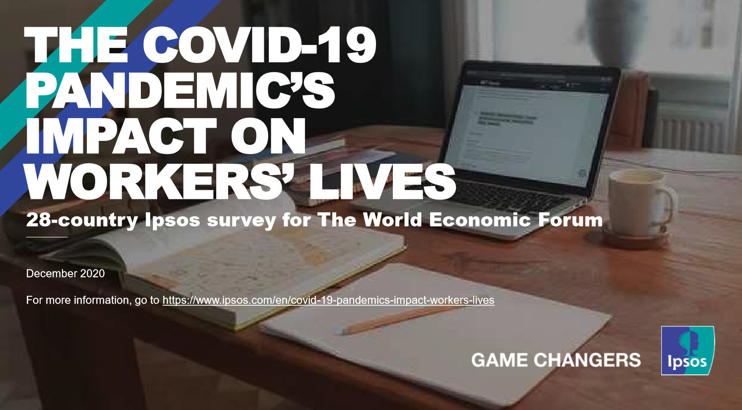
The Pandemic and Working Life
Ipsos (2020). The Covid-19 Pandemic’s Impact on Worker’s Lives. 28-country Ipsos survey for The World Economic Forum. Paris: Ipsos.

Slide 4
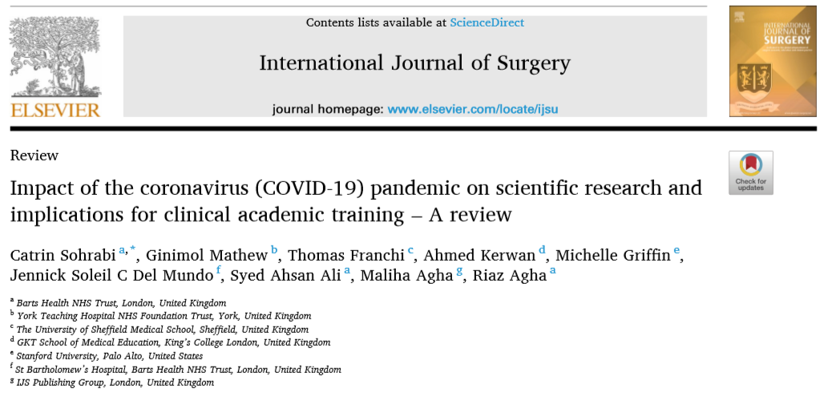
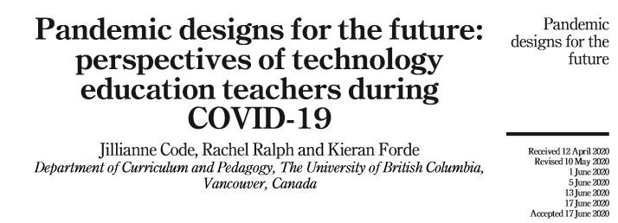
Practical implications for education and training
Sohrabi, C., Ginimol Mathew, G., Franchi, T., Kerwan, A., Griffin, M., Del Mundo, J.S.C., Ali, S.A., Agha, M., & Agha, R. (2021). Impact of the coronavirus (COVID-19) pandemic on scientific research and implications for clinical academic training – A review. International Journal of Surgery 86, 57–63. https://doi.org/10.1016/j.ijsu.2020.12.008.
Code, J., Ralph, R., & Forde, K. (2020). Pandemic designs for the future: perspectives of technology education teachers during COVID-19. Information and Learning Sciences. DOI 10.1108/ILS-04-2020-0112.

Slide 5
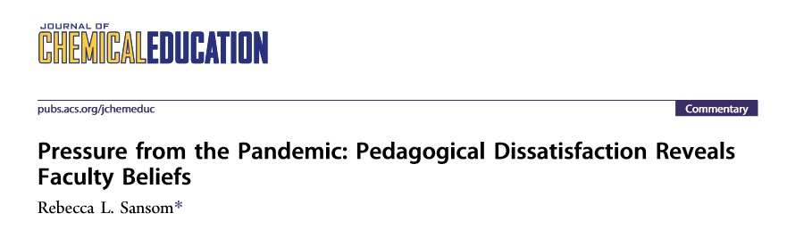
Pressure on Teachers
Sansom, R.L. (2020). Pressure from the Pandemic: Pedagogical Dissatisfaction Reveals Faculty Beliefs. Journal of Chemistry Education, 97, 2378−2382.

Slide 6
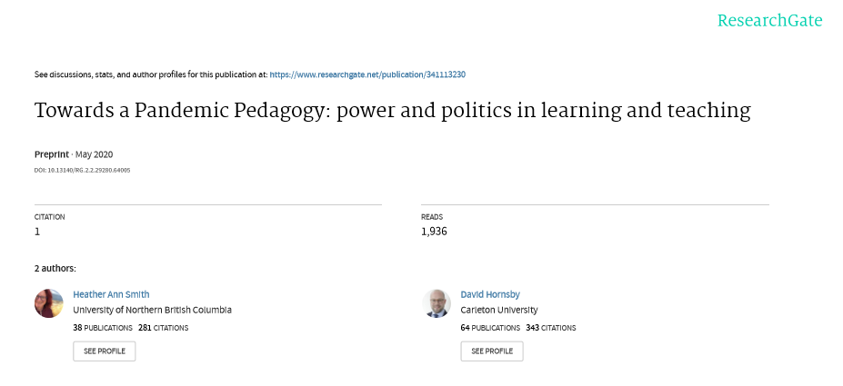
A sociological interpretation
Smith, H.A., & Hornsby, D. (2020). Towards a Pandemic Pedagogy: power and politics in learning and teaching. DOI: 10.13140/RG.2.2.29280.64005

Slide 7
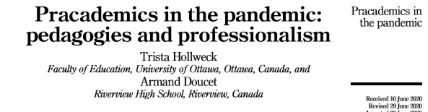
Pandemic as opportunity
Hollweck, T., & Doucet, A. (2020). Pracademics in the pandemic: pedagogies and professionalism. Journal of Professional Capital and Community. DOI 10.1108/JPCC-06-2020-0038 (accessed 20-03-2021).

Slide 8
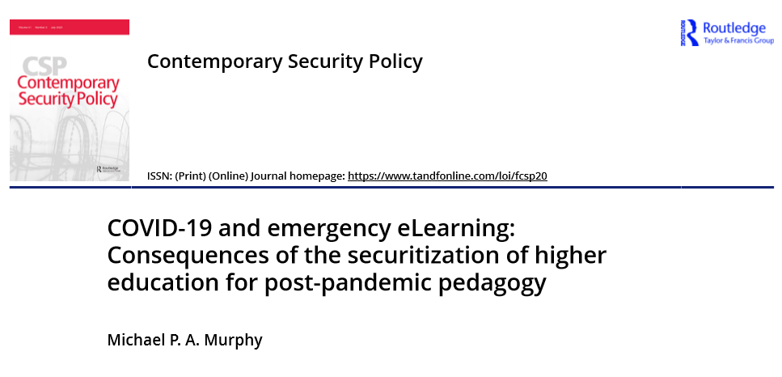
(De)securization
Murphy, M.P.A. (2020). COVID-19 and emergency eLearning: Consequences of the securitization of higher education for post-pandemic pedagogy. Contemporary Security Policy, 41(3), 492-505. DOI: 10.1080/13523260.2020.1761749.

Slide 9
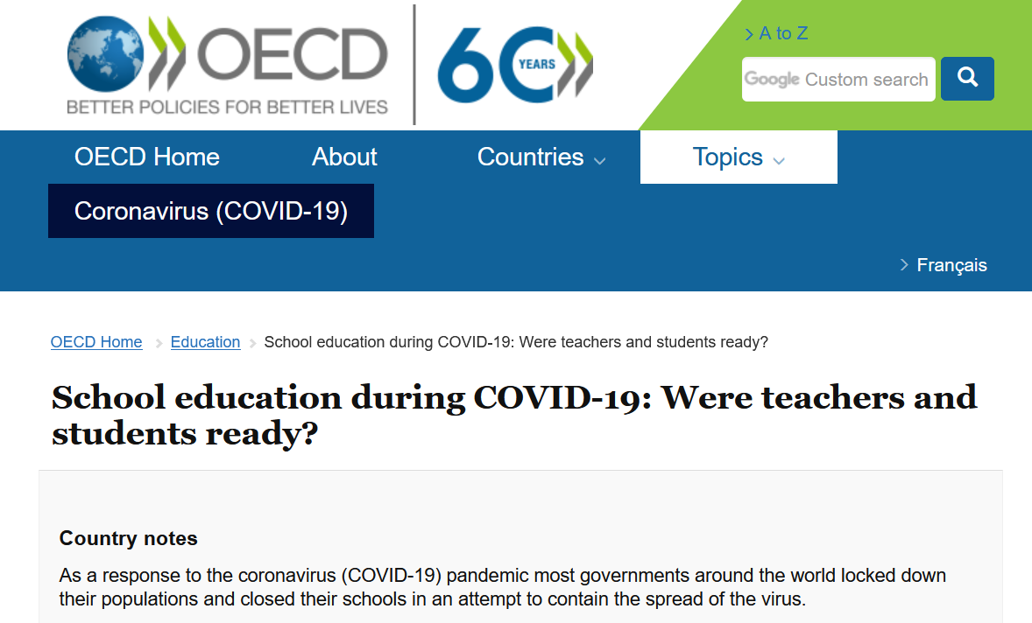
Further information - worldwide
OECD (2020). Education responses to COVID-19: Embracing digital learning and online collaboration. Paris: OECD. https://www.oecd.org/coronavirus/policy-responses/education-responses-to-covid-19-embracing-digital-learning-and-online-collaboration-d75eb0e8/ (Accessed 20-03-2021).

Slide 10
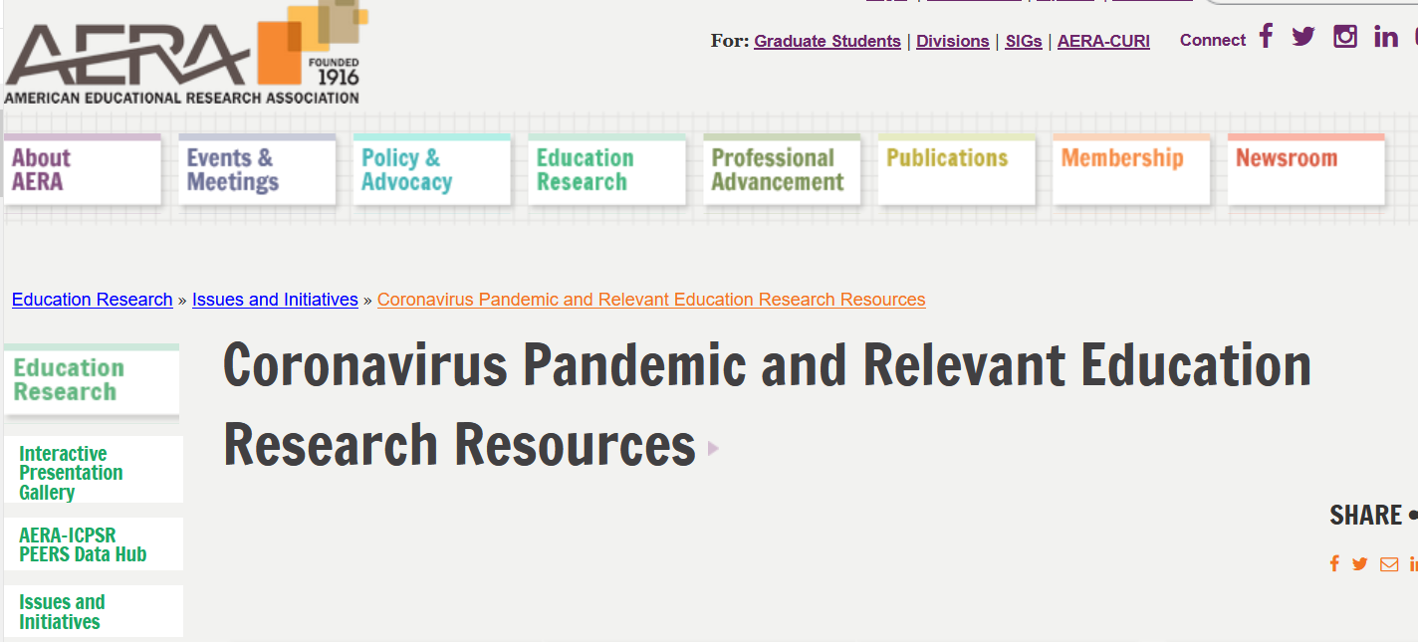
Sources
https://www.aera.net/Education-Research/Issues-and-Initiatives/Coronavirus-Pandemic

Slide 11


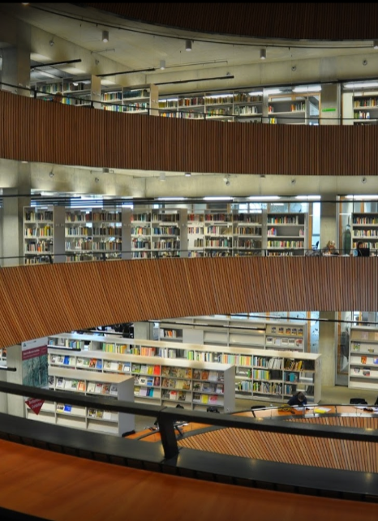



Inside Wageningen University
Stevens, T., Den Brok, P., Biemans, H.J.A., & Noroozi, O. (2020). The Transition to Online Education. A Case Study of Wageningen University & Research. (period 5). Wageningen: Wageningen University, Education and Learning Sciences Group, in collaboration with Education & Student Affairs.
Stevens, T., Den Brok, P., Biemans, H.J.A., & Noroozi, O. (2020). The Transition to Online Education. A Case Study of Wageningen University & Research. Report 2: period 6. Wageningen: Wageningen University, Education and Learning Sciences Group, in collaboration with Education & Student Affairs.

Slide 12
Competence for life
Self-management and career competence
Integrative
learning
competence
Personal-professional competence
Social-professional competence
Disciplinary and interdisciplinary competence
Mulder, M. (2017). A Five-Component Future Competence (5CFC) Model. The Journal of Agricultural Education and Extension, 23(2), pp. 99-102, DOI: 10.1080/1389224X.2017.1296533.

Slide 13
Integrative learning competence
Leadership competence
Handling ambiguity
Dealing with vulnerability
Handling uncertainty
Synthesizing competence
Evaluation competence
Coping with ambiguity
Sustainability competence
Developmental competence
Transformation competence
Knowledge co-creation competence

Slide 14
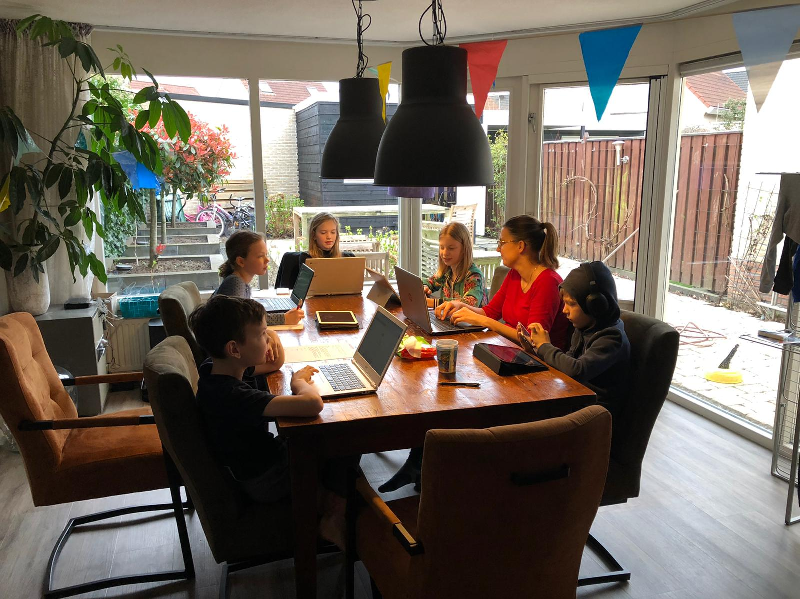
Lockdown: Living, working and learning in the digital world

